Slide 1
Niner Connect
Group 4: Stephen Zargo, Ian York, Shawn Kiruba, Adam Dauda, Nguyen Pham

Slide 2
Project Recap - Niner Connect
Niner Connect - A directory platform for students to find contact information for those in similar classes
Web-based application using Flask, Python, SQL, HTML, CSS, JavaScript
Originally planned to be a social-media like
Final product acts more as a student/course directory
Main Goal - Create a platform for students to connect with others based on their course selection or interest. Give students a way to connect with other students by seeing who is enrolled in what courses.

Slide 3
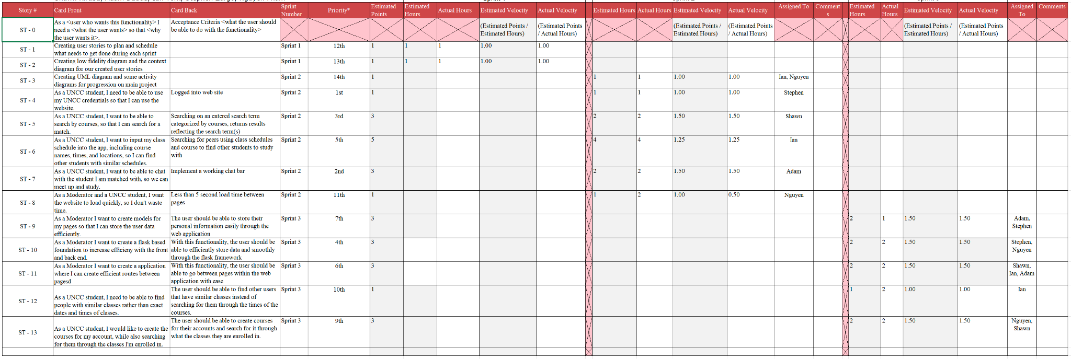
User Stories/Product Backlog

Slide 4
What we accomplished
Working web application
Signup/Sign in
Secure Database
Friend Suggestions
Mutual Friendships
Fast, Well Designed Pages
Add/Remove Friends and Courses
Schedule View Including Friendships
Profile Page

Slide 5
What we didn’t accomplish
Chat bar/Post Features/Social Media functionality
CRN Registration/UNCC Schedule Import
Friend Requests
Profile Picture Upload

Slide 6
Project Experience - Ian York
Project Planning
Project Design
Development
Development Challenges
Conclusion

Slide 7
Project Experience - Stephen Zargo
Overall it was what I expected. In Software Engineering, and especially in a class setting, it can be hard trying to gauge where we’re at with the project week by week. We’re all college students so we have busy lives and schedules and life events happening so it can be stressful with all our other classes trying to schedule everything.
Our initial plans were a bit more than we were able to implement, but that’s how Software engineering is in a class setting. We weren’t able to get to a few polishing features, but we were able to plan and implement a software that can be a genuine useful tool to students.
As time went on our technology changed and evolved a bit to what worked best for us and what everyone was more comfortable with and could work in. So we had to update our design documentation with that.

Slide 8
Project Experience - Shawn Kiruba
Our project was a very unique application, I was very interested with the features of connecting with other students who were in the similar courses. Some user stories that I was interested in was the feature of connecting with other students and also finding courses with similar course names or professors. This was a very well organized application with many features that provided the users seamless experience in finding and adding courses as a social media network. Some major features that I wanted implemented and that were implemented were things like finding courses and adding courses into the social media platform so that I can not only search for my own courses but also search for other students courses who have similar classes. One major challenge that I had was time, during this semester it was really hard to find time to work together with my classmates and contribute, but I was able to organize my own schedule throughout the semester and I was able to make time to mainly contribute to the teamwork part of the project, filling out user stories and working on documentation that supported our project.

Slide 9
Project Experience - Adam Dauda
Throughout the development of Niner Connect, our team faced several significant challenges that required creative problem-solving and a deep understanding of the application's requirements. One of the major problems was enabling real-time class schedule synchronization across multiple users and we needed to develop a system that could handle schedule updates in real-time, while also maintaining data consistency and resolving potential conflicts.
Incorporating social features, such as the ability to connect with classmates and being able to chat with them was a key aspect of fostering a sense of community and driving user engagement. However, I was tasked with the social chat, but I was not able to complete it. Throughout the development process, I made contributions to various aspects of the project such as the user stories and the product backlog.

Slide 10
Project Experience - Nguyen Pham
It was interesting to research different design infrastructures that is scalable in the future. Originally we went with using cloud database to save resources on sharing local database with each other but, but it was becoming expensive for our use case short-term, so we opted for the local ones instead. We also tackle various different concepts of how to design a good design doc like UML diagrams, use case, user stories, etc., which I believe is very important in the long run when we work full-time as software engineers. Another important thing I learned is analyzing customer’s needs and requirements of the product, as well as taking into account the technical resources that make sense in the context of the stakeholders and team members, so the product development process can be efficient either long term or short.

